Slide 1
How Robust is Comparative Advantage?
Alan V. Deardorff
Gerald R. Ford School of Public Policy
University of Michigan
For presentation at Beijing Institute of Technology
June 7, 2012, Beijing

Slide 2
The Issue
How well does the concept of Comparative Advantage (CA) work beyond the simple 2×2 framework in which Ricardo explained it?
The answer depends, in part, on what you interpret CA to mean:
If it refers to the gains from trade, then it is very robust
If it is meant to predict trade in particular goods, then it generalizes poorly
But weak generalizations are possible and robust.
Overall, CA is a fundamental and valuable concept.

Slide 3
The Source
Alan V. Deardorff, “How Robust is Comparative Advantage?,” Review of International Economics 13(5), November 2005, pp. 1004-1016.
Which draws on:
“Weak Links in the Chain of Comparative Advantage,” Journal of International Economics 9 (1979):197–209.
“The General Validity of the Law of Comparative Advantage,” Journal of Political Economy 88 (1980):941–57.
“Exploring the Limits of Comparative Advantage,” Weltwirtschaftliches Archiv 130 (1994):1–19.

Slide 4
CA in Ricardo
The Ricardian Model:
2 goods: 1, 2
2 countries: 1, 2
1 factor: L = labor
Constant costs: = labor needed to produce one unit of good g in country c
Perfect competition

Slide 5
CA in Ricardo
A country has comparative advantage in the good whose relative labor cost (compared to the other good) is lower than in the other country.
Country 1 has CA in good 1,
relative to good 2,
compared to country 2,
if
Note, this is the same as

Slide 6
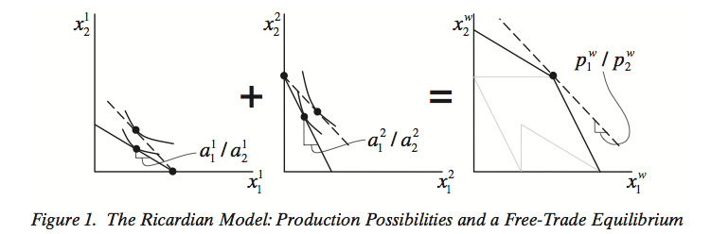
CA in Ricardo

Slide 7
CA in Ricardo
Implications
CA gives the opportunity for the world to increase output of everything by specializing
Thus CA implies Gains from Trade
These gains are obtained by each country…
…specializing in...
…and exporting…
…the good in which it has comparative advantage.

Slide 8
CA in Ricardo
Thus CA is about two things:
The opportunity to Gain from Trade
Prediction of the Pattern of Trade
(who exports what)
As we’ll see
Gain from Trade is very robust
Pattern of Trade is much weaker

Slide 9
CA in Haberler (1930)
The Ricardian Model assumed
only labor as a factor, and
constant unit labor requirements (the a’s).
That is very restrictive, as more modern models drop both assumptions
The Heckscher-Ohlin Model
The Specific Factors Model
These models are easily analyzed with a curved Production Possibility Frontier, together with Community Indifference Curves.

Slide 10
CA in Haberler (1930)
CA is still easily defined in terms “opportunity cost,” which is measured by relative autarky prices, :
A country has comparative advantage in the good whose autarky price, relative to the other good, is lower than in the other country.
Country 1 has CA in good 1,
relative to good 2,
compared to country 2,
if

Slide 11
CA in Haberler (1930)
Autarky equilibrium:

Slide 12
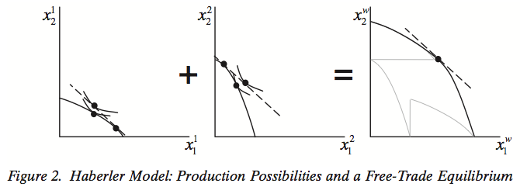
CA in Haberler (1930)

Slide 13
CA and Gains from Trade
In Haberler’s model, it is again true that
If countries differ in relative autarky prices, there is both CA and Gain from Trade
In order to gain from trade, they must export the good in which they have CA
Note that trading in accord with CA is necessary, but not sufficient for gain from trade.

Slide 14
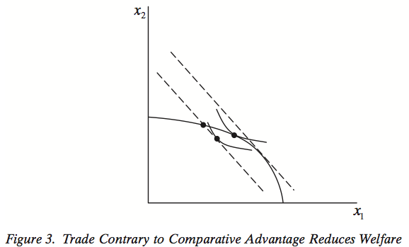
CA and Gains from Trade
CA is necessary for Gain from Trade:

Slide 15
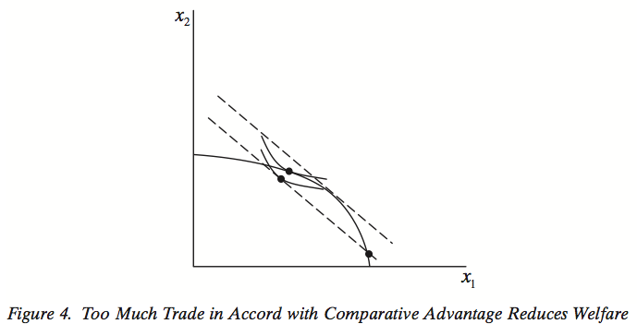
CA and Gains from Trade
It is not sufficient:

Slide 16
Strong Generalizations of CA
With many (C) countries and only 2 goods:
Rank the countries in order of :
Then all countries that export good 1 will lie to the left of all that export good 2
Location of the line (c₁, c₂) depends on country sizes.
Export 1
Export 2

Slide 17
Strong Generalizations of CA
With many (G) goods and only 2 countries, a similar chain of comparative advantage works, but only in the Ricardian Model:
Rank the goods in order of relative labor requirements in the two countries:
Then all goods that country 1 exports will lie to the left of all that it imports.
This does not work with variable costs in Haberler’s model, since costs can be interdependent.

Slide 18
Strong Generalizations of CA
Even these “chain propositions” fail, in both Ricardian and Haberler models, if there are both
Intermediate inputs
Barriers to trade
This is shown in Deardorff (1979), in the context of the Heckscher-Ohlin trade model.
It can be illustrated also in a Ricardian Model with intermediate inputs, as follows:

Slide 19
Impossibility of Strong CA
Example: Assume…
4 goods:
Steel, input to Autos
Wool, input to Cloth
(1 unit → 1 unit, each)
2 countries of equal size
Demands for autos and cloth: equal expenditure shares

Slide 20
Direct unit labor requirements | Goods
 | W Wool | A Autos | C Cloth | S Steel
Country 1 | 1 | 2 | 3 | 4
Country 2 | 4 | 3 | 2 | 1
Direct+Indirect unit labor requirements | Final Goods
 | A Autos | C Cloth
Country 1 | 2+4=6 | 3+1=4
Country 2 | 3+1=4 | 2+4=6

Slide 21
If all goods are traded without cost
Results:
Country 1 exports autos (and wool)
Country 2 exports cloth (and steel)
Direct unit labor requirements | Goods
 | W Wool | A Autos | C Cloth | S Steel
Country 1 | 1 | 2 | 3 | 4
Country 2 | 4 | 3 | 2 | 1

Slide 22
If only final goods are traded
Results:
Country 1 exports cloth
Country 2 exports autos
Direct+Indirect unit labor requirements | Final Goods
 | A Autos | C Cloth
Country 1 | 2+4=6 | 3+1=4
Country 2 | 3+1=4 | 2+4=6

Slide 23
Impossibility of Strong CA
Results of Example: Summary
If all goods are traded without cost
Country 1 exports autos
Country 2 exports cloth
If inputs, steel and wool, are not traded
Country 1 exports cloth
Country 2 exports autos
Thus, trade in autos and cloth reverse if steel and wool are not traded.

Slide 24
Impossibility of Strong CA
Implication: Any definition of CA that predicts trade correctly in one case will be wrong in the other.
(Unless the definition itself takes account of trade costs. That’s something I won’t address here, though I do in another place.)

Slide 25
Weak Generalizations of CA
What does hold in general – with any numbers of goods and countries, as well as many other relaxed assumptions – is that CA predicts the Pattern of Trade On Average.
Specifically, letting be net exports of good g by country c (so that for an import), then
Theorem:
This says (since the vector T^{c} has positive elements for exports and negative for imports) that autarky prices of exports are lower than of imports.

Slide 26
Weak Generalizations of CA
More formally, letting
That is, the country’s trade-weighted autarky prices relative to world prices, p^{w}, are lower for its exports than for its imports.

Slide 27
Weak Generalizations of CA
Other interpretations involve correlations, stated as Corollaries of (6) in Deardorff (1980).
Corollary 1:
The simplest – and similar to (7) – is a negative correlation between a country’s autarky prices relative to the world and the value at world prices of its trade:

Slide 28
Weak Generalizations of CA
Most broadly, autarky prices and trade are negatively correlated across all goods and countries:
Corollary 4:
Let be a CG length vector of all
and E be a vector of the
same length of all
then

Slide 29
Weak Generalizations of CA
Proof of Theorem (omitting country superscript):
Notation: T = Q – C, where Q and C are vectors of output and consumption with trade, and are vectors of output and consumption in autarky .
First the Gains from Trade:

Slide 30
Weak Generalizations of CA
Proof (continued):
by Weak Axiom of Revealed Preference
(WARP)

Slide 31
Weak Generalizations of CA
Result permits: (I used more assumptions for the simple proof above, but the paper allows much greater generality.)
Multiple goods and countries (also, implicitly, multiple factors of production)
Tariffs and other artificial trade costs
Transport costs and other real trade costs
Intermediate inputs
Note that these assumptions are enough to include the example earlier, where CA failed to predict trade of cars and cloth, with inputs of steel and wool

Slide 32
Direct unit labor requirements | Goods
 | W Wool | A Autos | C Cloth | S Steel
Country 1 | 1 | 2 | 3 | 4
Country 2 | 4 | 3 | 2 | 1
Assume wages = $1 in both
Autarky prices
 | W | A | C | S
Country 1 | 1 | 6 | 4 | 4
Country 2 | 4 | 4 | 6 | 1

Slide 33
Assume
Labor endowments = 120 in both
Consumers demand equal units of cloth and autos
Without trade in inputs
Country 1
exports 15 cloth and
imports 15 cars
With trade in inputs
Country 1
exports 20 wool and 20 autos
Imports 20 steel and 20 cloth
Wool
Autos
Steel
CLoth

Slide 34
Weak Generalizations of CA
Result also permits:
Arbitrary preferences of consumers
Services, traded or not
Dated goods
Differentiated goods
Unbalanced trade
Lumpy countries

Slide 35
Weak Generalizations of CA
Result does not permit:
Domestic distortions
Increasing returns to scale
Note though that while these can interfere with the result if they vary across sectors or countries so as to undermine CA, they could also do the opposite, enhancing CA.
Thus their presence “suggests only that we are ignorant, not necessarily that we are wrong.”

